Slide 1


Day 3: Advanced Grafana & Dashboards
Notes:
Introduction & Objectives:
Firstly, we would like to thank you for choosing CMC as Managed Service provider. Thank you for taking the time to attend Kickoff meeting today.
This kickoff meeting shall lay the foundation for a successful Managed Service project, ensure HSG and CMC teams are on the same page with the scope, objectives, timeline, communication and everything in between.
At CMC side, we have Mr. Lam is Service Delivery Manager, v.v.. Sales, technical guys
Could you introduce HSG’s members

Slide 2




Creating Dashboards & Panels in Grafana
Dashboards & Panels
Data Integration
Dashboards are collections of panels. Panels visualize data through various types: time series, bar, pie charts, gauges, tables, and stat panels.
Start by selecting your data source. Write powerful queries to retrieve the exact data needed for your visualizations.
Visualization & Customization
Data Transformation
Choose the best visualization type. Customize panels and use variables for dynamic filtering, such as server names or time ranges.
Apply transformations to manipulate query results, enhancing clarity and presenting data in a more digestible format for analysis.

Slide 3
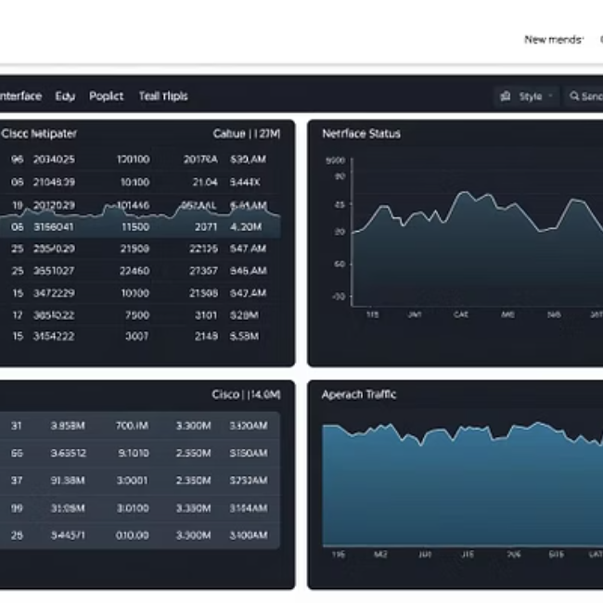
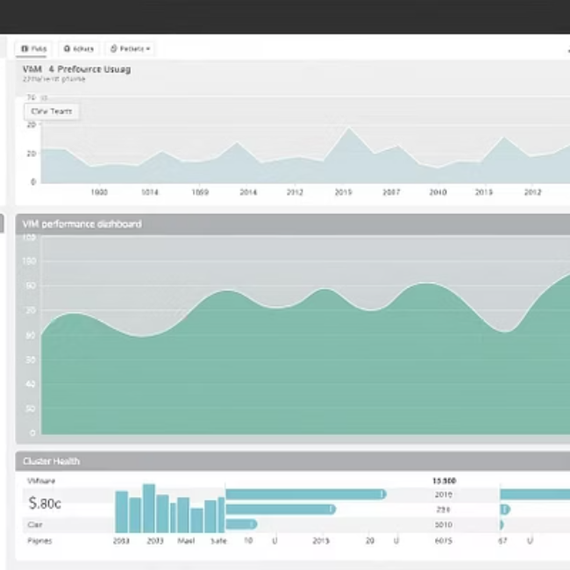
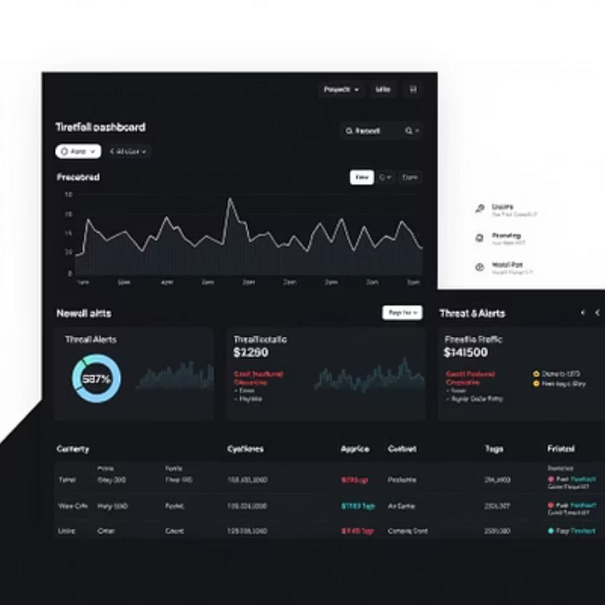
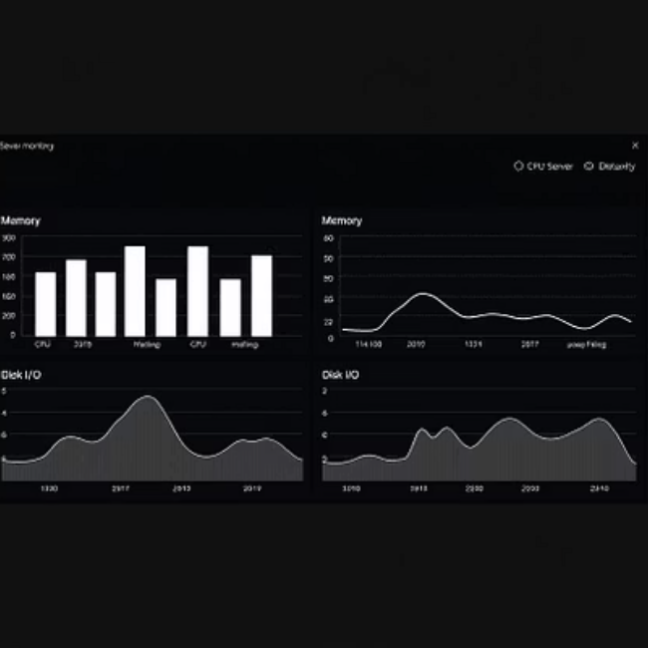

Sample Dashboards: Network & System Monitoring
Explore pre-built and custom dashboards for various systems:
Cisco for network performance
VMware for virtualized environments
Dashboards for firewalls, network devices, Linux, and Windows.
Leverage Grafana.com's community dashboards for quick deployment.

Slide 4
Advanced Features & Customization Tips
1
Scalable Dashboards
Utilize chained and templated variables to create highly scalable dashboards that adapt to different
contexts and data sets.
2
Alerts & Annotations
Add annotations to highlight specific events and configure alerts for instant notification of anomalies.
3
Enhanced Visuals
Customize panel titles, legends, and color schemes for optimal clarity and visual appeal.
4
Advanced Visualizations
Explore heatmaps and geomaps for detailed pattern recognition and geographic data analysis.
5
Interactive Exploration
Create drilldown links to enable interactive data exploration, allowing users to dive deeper into
specific metrics.

Slide 5
Thank you

